Slide 1
Substance Use
Manuja Perera
Department of Public Health
Faculty of Medicine, University of Kelaniya

Slide 2
Substance
A chemical compound
Tobacco
Alcohol
Illicit drugs
cannabis, amphetamines, cocaine, opioids, and non-prescribed psychoactive prescription medication

Slide 3
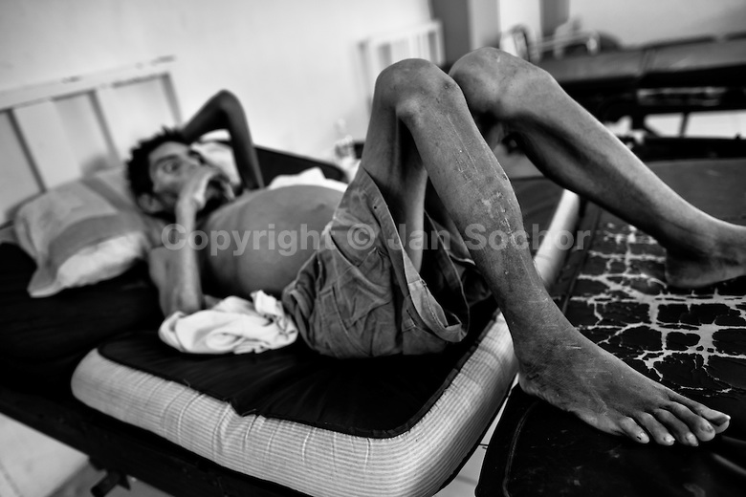
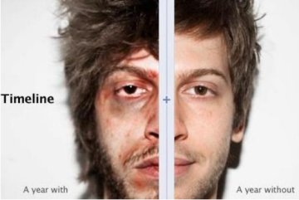
Waste resources - Men, Money & Time
Impair wellbeing

Slide 4
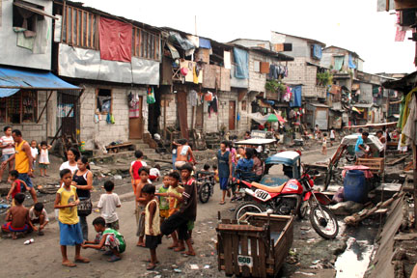
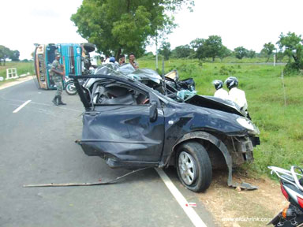

Lead to a range of socio-economic adverse effects

Slide 5
Alcohol
There are many myths regarding alcohol….

Slide 6
Myth #1
Drinking alcohol is fun…….

Slide 7
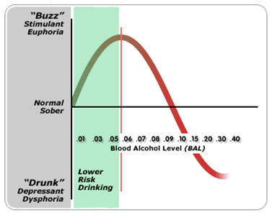
Maximum euphoria at .06????

Slide 8
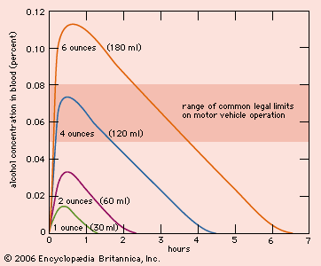
Blood alcohol levels over time
Level of happiness
Hearing the ‘news’

Slide 9

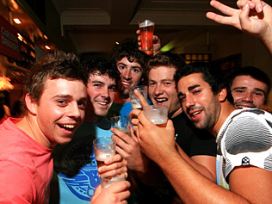


Slide 10
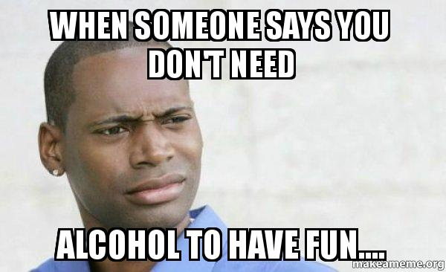

Slide 11
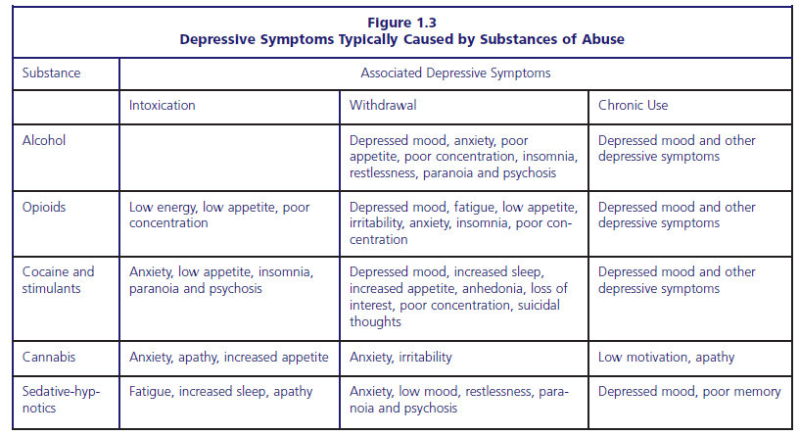
Where is the fun????

Slide 12
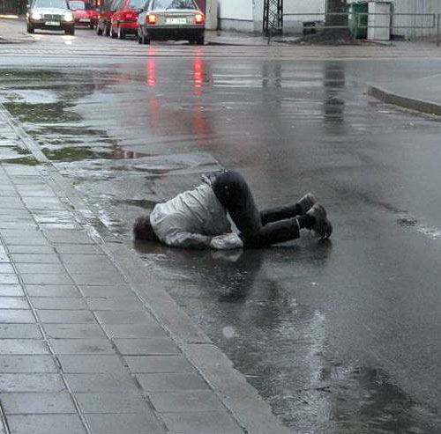

Slide 13
Myth #2
There are safe levels of alcohol…….

Slide 14
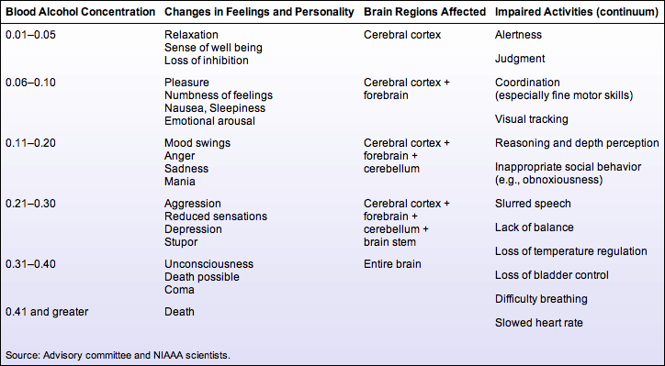

Slide 15
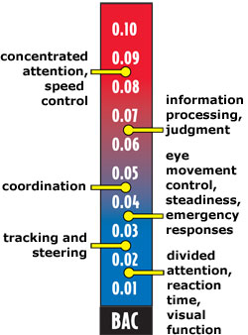
BAC & impairment of driving skills

Slide 16
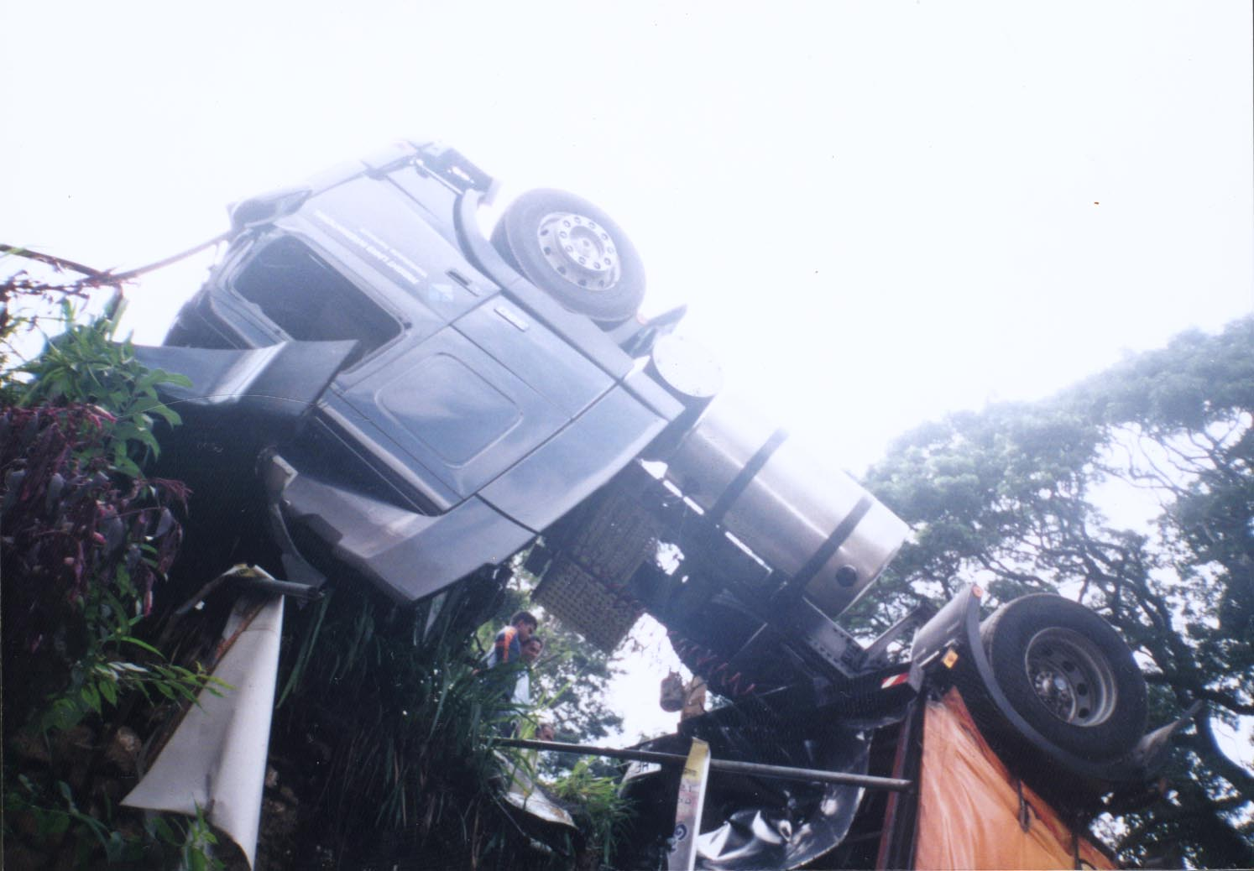

Slide 17
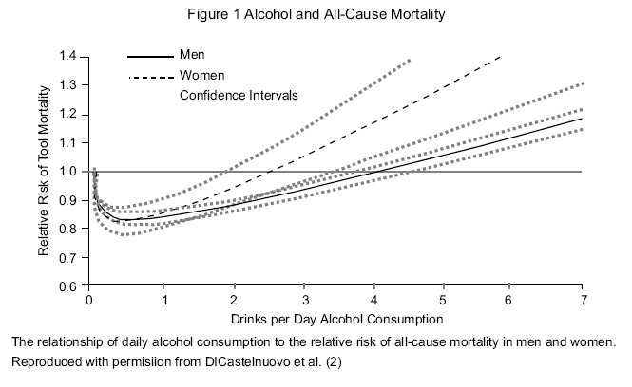

Slide 18
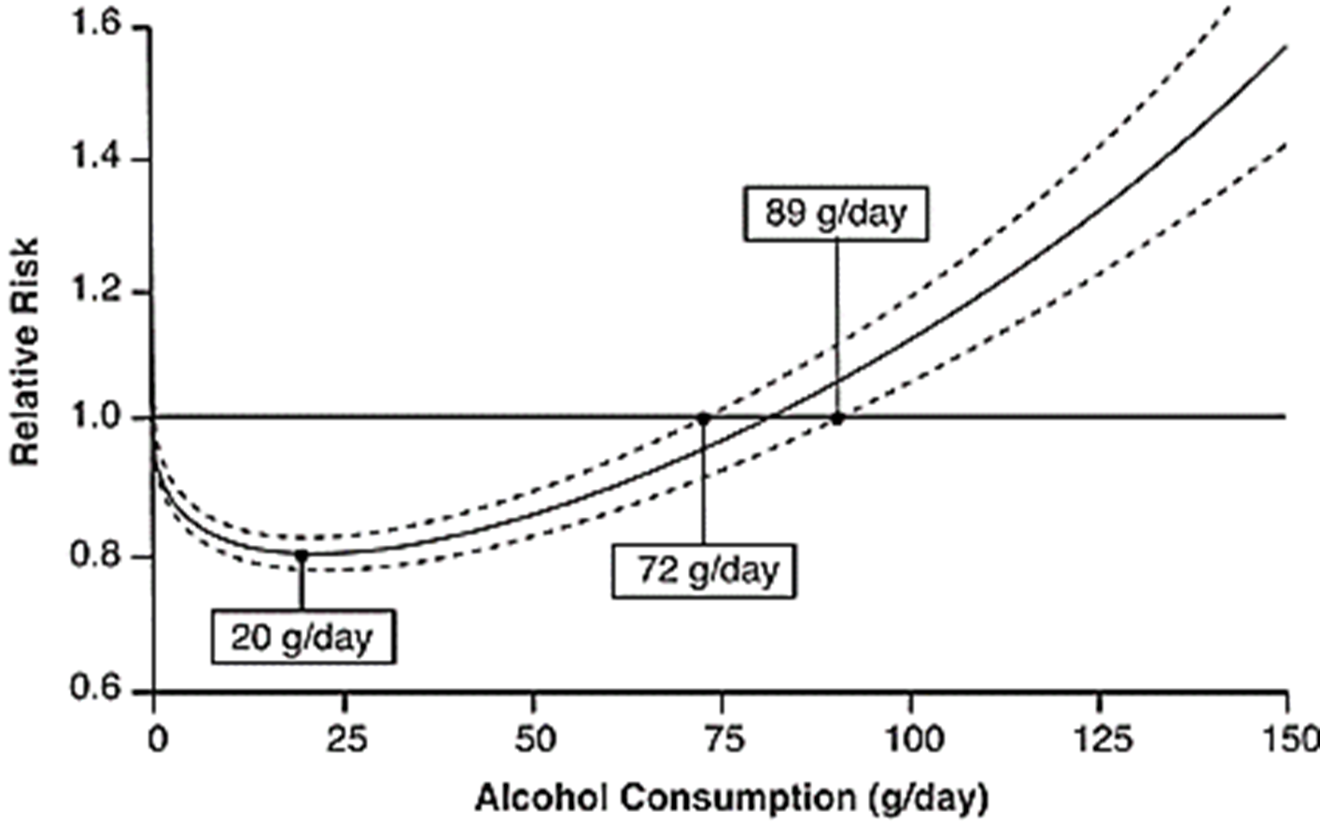
Notes:
Which was proven wrong about decade ago by plethora of evidence against it… it is clearly mentioned that the findings were attributed to inappropriate selection of the referent group and not adequately considering the other factors that can affect the relationship… when adjusted to confounders the J shaped straightens as for many other determinants of ill health…. If the exposure is more, risk is more… at individual as well as the population level….

Slide 19
Safe Drinking?

Slide 20
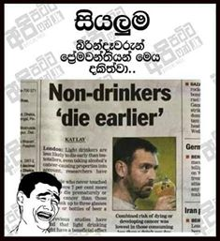

Slide 21
Myth #3
Only alcoholics themselves are to be blamed for their habit…….

Slide 22
1) Alcohol industry
Alcohol industry uses many marketing strategies to promote their products………..
Media plays a major role………..

Slide 23
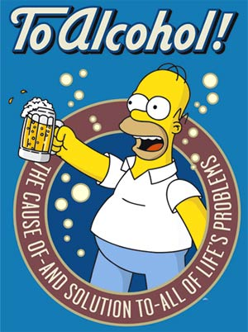
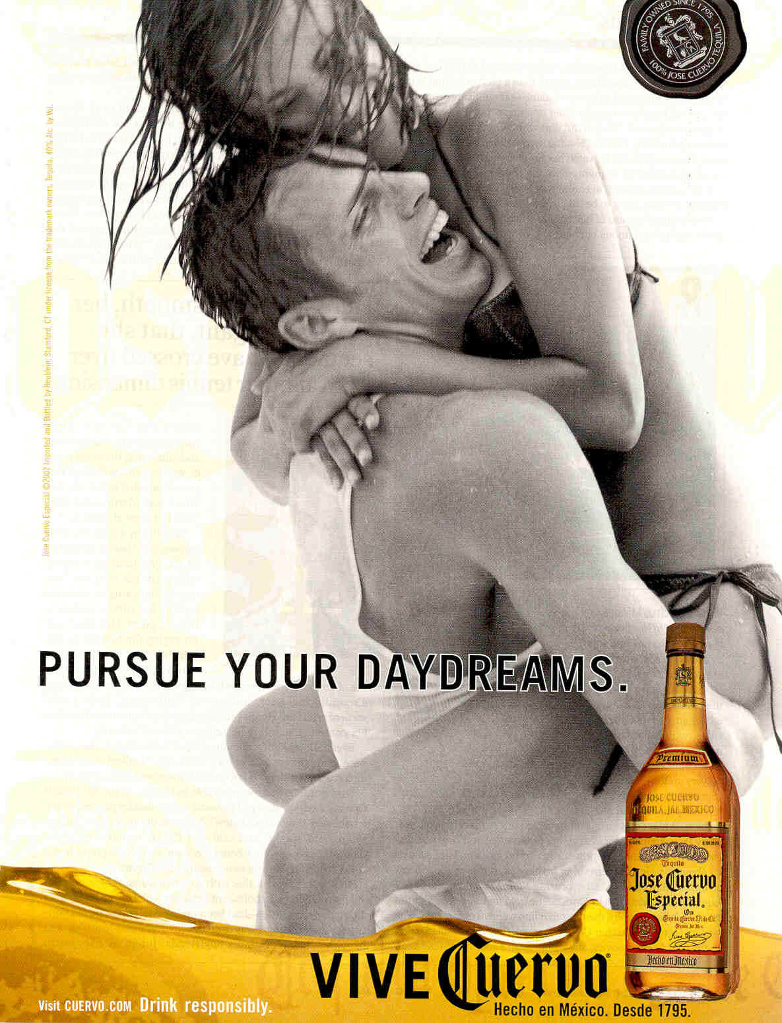
“Alcohol = fun”

Slide 24
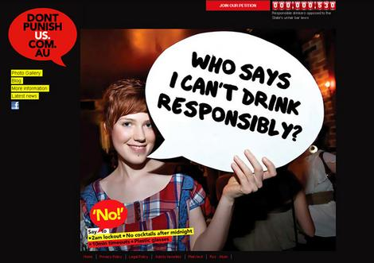
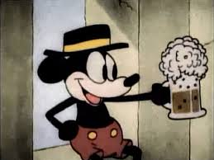
“Alcohol = growing up”

Slide 25
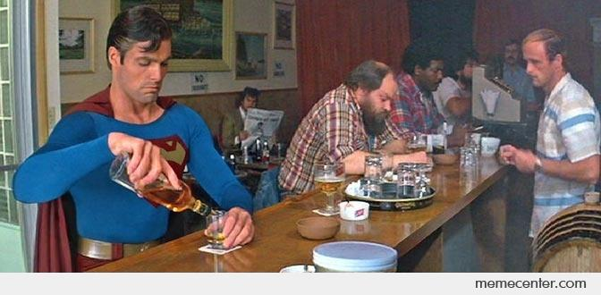

“Alcohol = power”

Slide 26

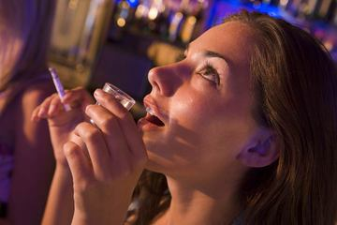
“Alcohol = fashion”

Slide 27
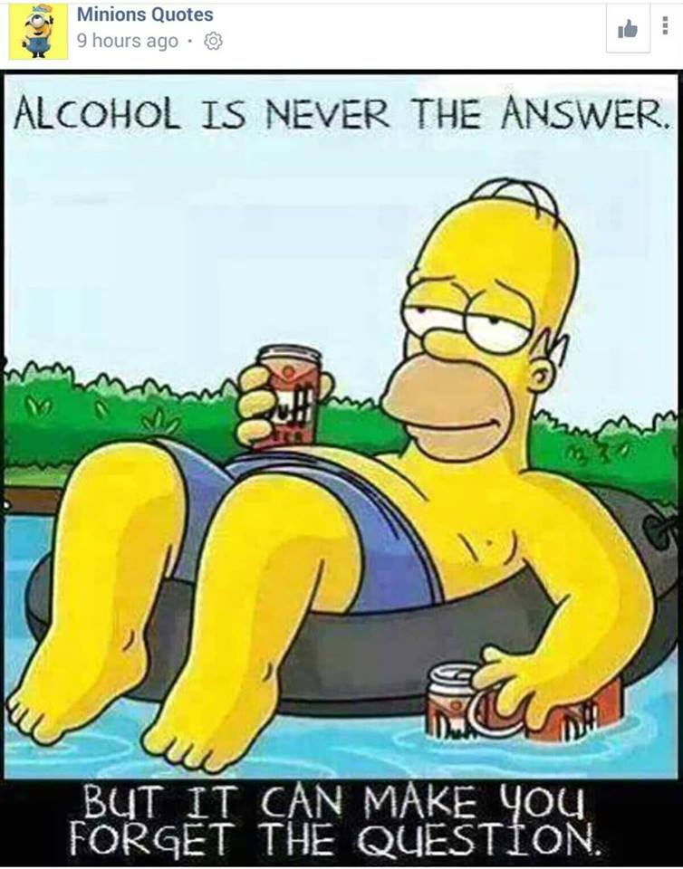
“Alcohol = solution”

Slide 28
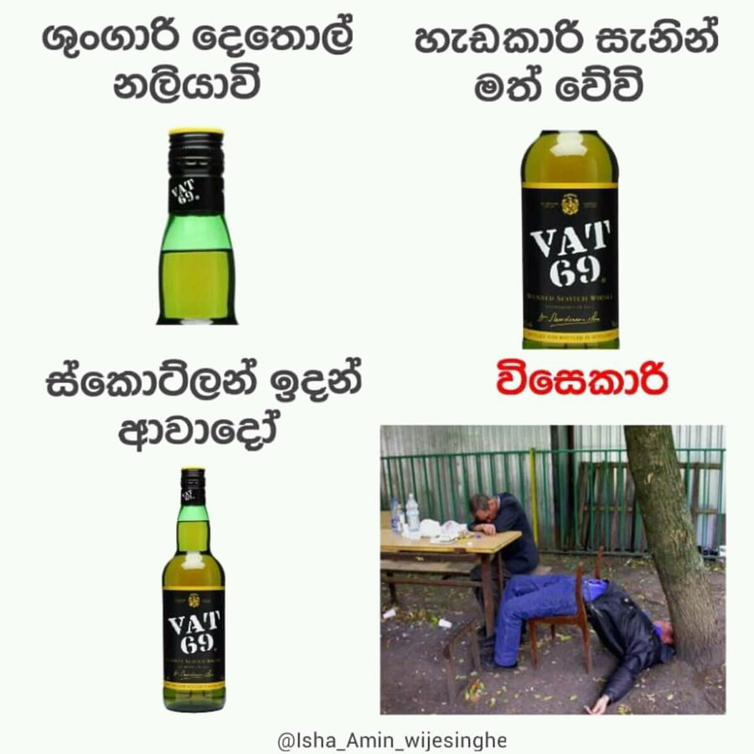
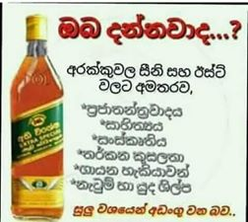

Slide 29

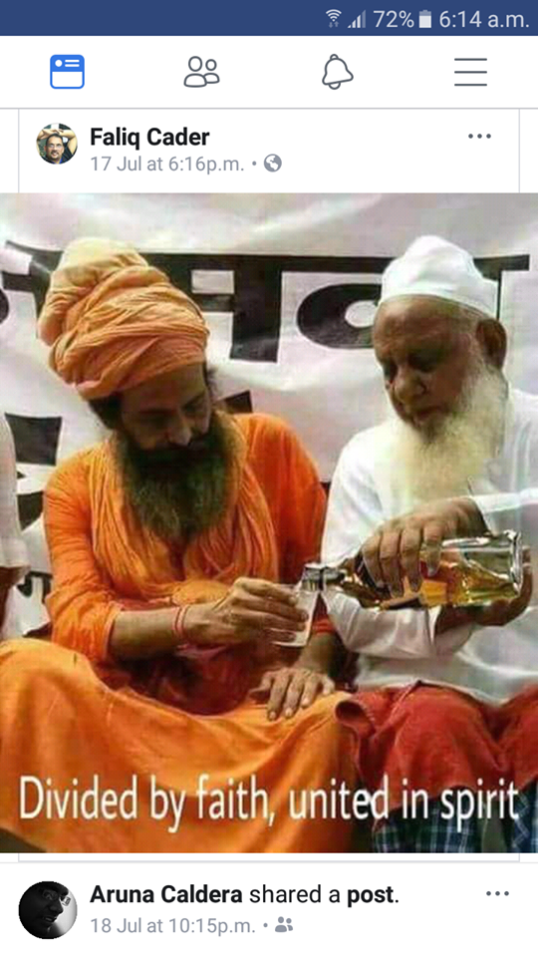

Slide 30
2) Friends (????) / People you drink with

Slide 31
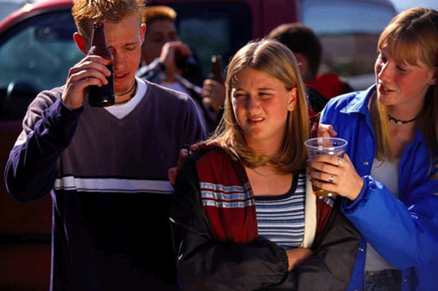
“Have a drink…..have one more…..”

Slide 32
Myth #4
Drugs are a bigger problem than alcohol…….

Slide 33
Alcohol contributes to 2.5 million deaths each year (more deaths than by HIV/AIDS or TB)
The world’s leading risk factor for death among males aged 15–59

Slide 34
International Classification of Diseases (ICD)-has more than 30 diseases that include alcohol consumption as the causal factor
In addition, over 200 disease codes identify alcohol as a major risk factor

Slide 35
Reducing harm from alcohol - Objectives
Delay initiation of use
Reduce heavy alcohol use
Minimize harmful patterns of consumption
Reduce population consumption
Change harmful behaviours associated with alcohol use

Slide 36
Other substances

Slide 37
Global burden
In 2008, 155 to 250 million (3.5% to 5.7%) of the world's population aged 15-64, used other psychoactive substances
Globally, cannabis is the most commonly used (129-190 million people)

Slide 38
Marijuana in the Market
Is different!
Is more potent – 50% to 60% more Tetrahydrocannabinol (THC) levels
Genetically modified to the level of being a different plant
Loaded with fungicides and other chemicals to increase the shelf-life

Slide 39
Adverse Effects
An addictive substance
wastes men, money and time
Increase risk of Schizophrenia
Gives all the negative effects related to ‘smoking’

Slide 40
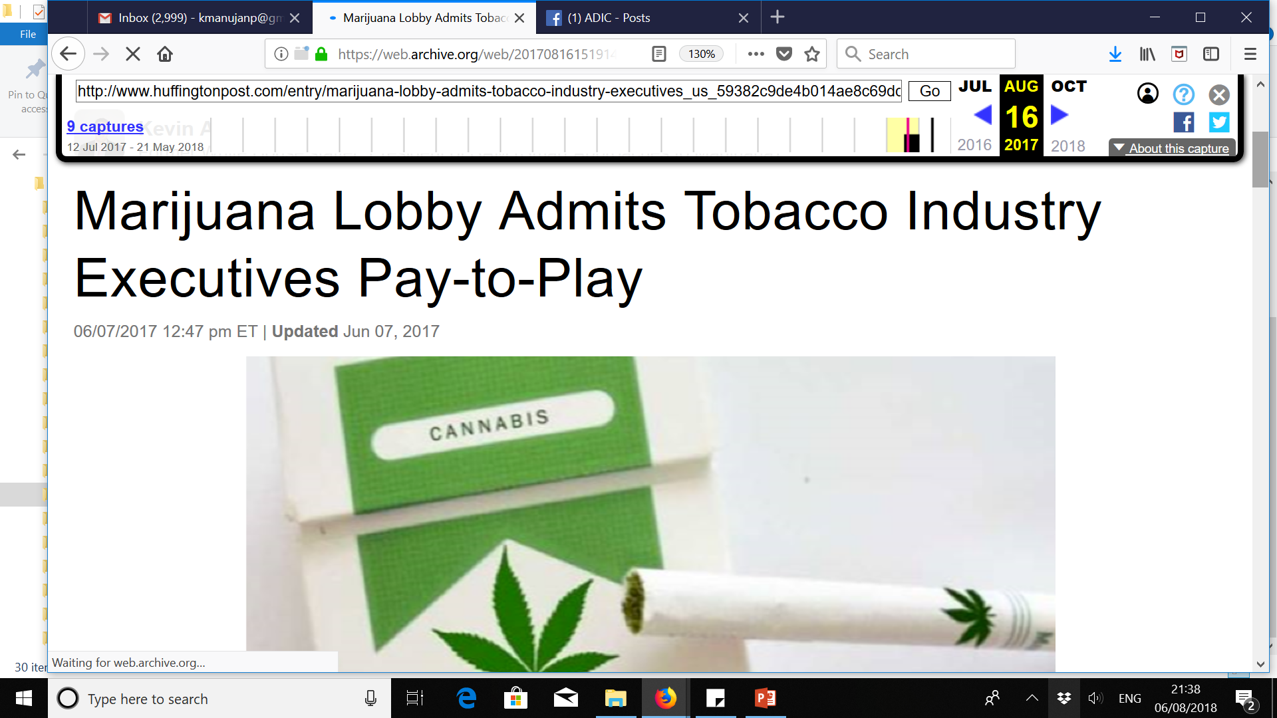
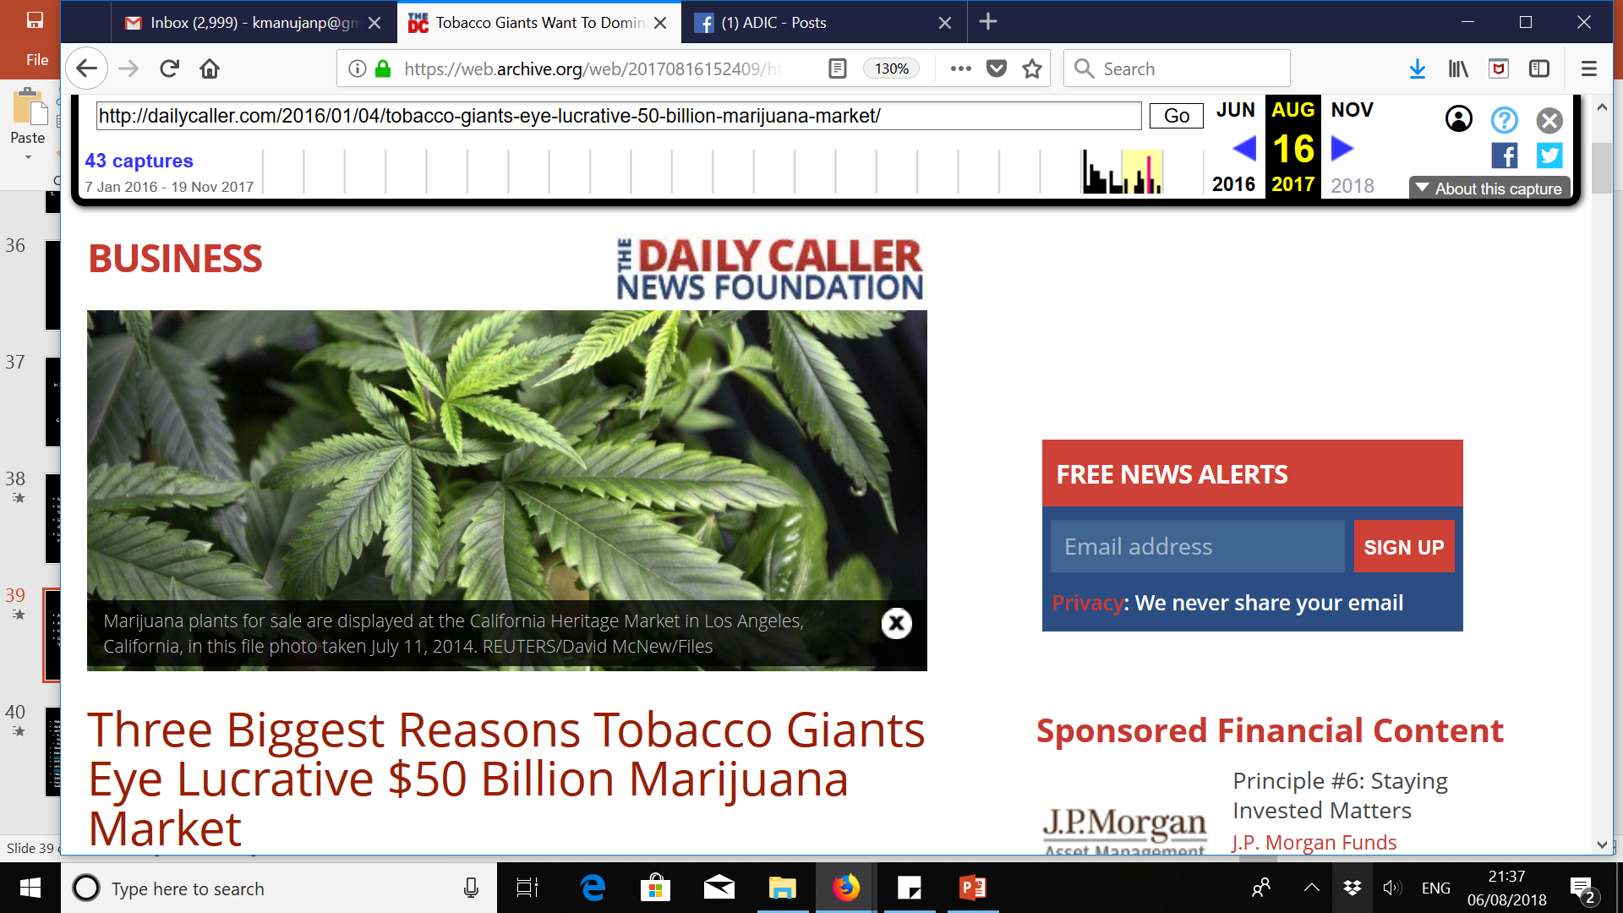

Slide 41
References
Global Status Report on Alcohol 2011 – World Health Organization
Alcohol and Drug Information Centre (ADIC)
WHO Alcohol Control Series – Books 2 & 5
Public Health Problems Caused by Harmful Use of Alcohol: Gaining Less or Loosing More? (#2)
Reducing Harm from Use of Alcohol: Community Responses (#5)
Strategies to Address Alcohol Problems – Prof. Diyanath Samarsinghe
National Dangerous Drugs Control Board (NDDCB)
http://www.who.int/substance_abuse/en/ - WHO Drug abuse facts
NATA Act Sri Lanka. : Available: http://www.nata.gov.lk/
WHO Tobacco Fact Sheet 2012 - Available: http://www.who.int/mediacentre/factsheets/fs339/en/
Help your patients quit smoking – D. Samarasinghe, V. De Silva & M. Fernando, SLMA 2003.
Framework Convention on Tobacco Control. World Health Organization, 2003. Geneva: Available: http://whqlibdoc.who.int/publications/2003/9241591013.pdf

